Slide 1
TEAM KENT
An innovative partnership between
The Kent City School District
&
Kent State University
College of Education, Health, and Human Services
Notes:
Karen

Slide 2
Welcome
What would you like to take with you from this session?

Slide 3
The beginning
The 3 of us and an aspirational idea

Slide 4
Our initial Purpose and why
A mutually beneficial partnership
What can we be doing FOR and WITH each other to support student and adult learning?
So much we already do…
So much we could do...
20XX | 20XX | 20XX | 20XX

Slide 5
Jump Start the Partnership
Identify key players
Bring them together
See what happens
Notes:
Jen

Slide 6
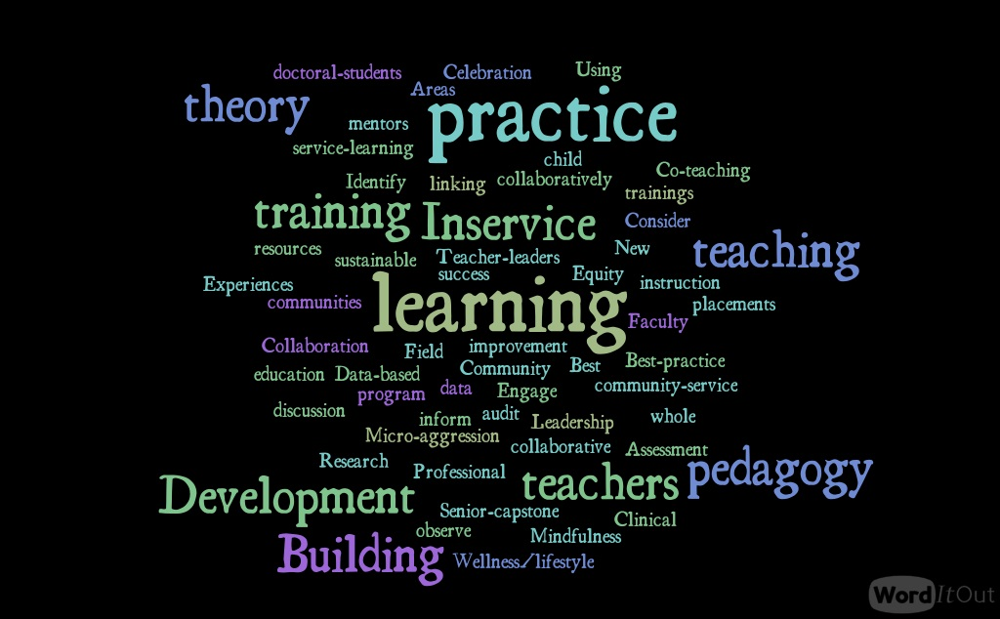
T k
E E
A N M T
V
A
L
U
E
S
Notes:
Values from the first meeting

Slide 7
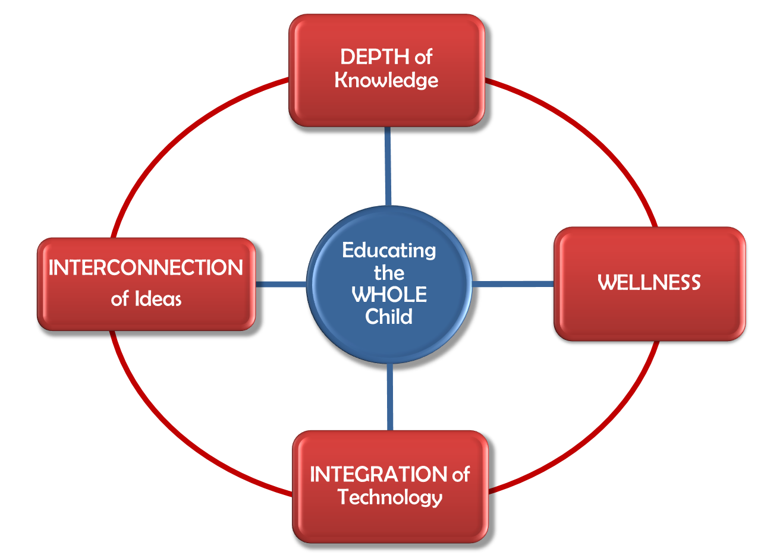
TEAM KENT Partnership 2017-18 Framework Kent City Schools & Kent State University
PARTNERSHIP
FACILITATORS
Alicia Crowe
Karen Rumley
Jennifer Walton-Fisette
Notes:
Developed from the first admin meeting

Slide 8
Year 1 Milestones
Oct. 18, 2017
May 2018
August 2017
Sept. 6, 2017
March 7, 2018
Large group collaborative brainstorming leads to Teams
Updates to organization leaders
We started dreaming… and kept on
Aug | Sept | Oct | Nov | Dec | Jan | Feb | Mar | Apr | May
Teams start to meet
First meeting of KCS and KSU leaders - we become TEAM KENT
Large group check-in

Slide 10
Key Players
Superintendent George Joseph
Asst. Supt. Tom Larkin
Team Leaders:
Courtney Baliman
Janice Byrd
Jenny Cureton
Justin Gates
Annette Kratcoski
Tom Larkin
Jason Miller
Lynn Guillot-Miller
Steve Mitchell
Bridget Mulvey
Daniel Nilsson
Linda Paulus
Todd Poole
Jim Soyars
Troy Spear
Daniela Stuckey
Janice Swan
Andrew Wiley

Slide 11
NEXT STEPS
Step 3
Step 2
Step 1
Whole group Collaboration and ‘18-19 Kick-Off: September
Reconnect with teams in August
Adopt Mission & Vision
Research project
Strengthen partnership & Streamline communication systems
Establish ‘18-19 Goals
Support and Communicate with Team Leaders

Slide 12
Your Turn
What whole district might your unit partner with?
Who would you contact to start such a process?
What might be the way to begin your partnership?

Slide 13
Mission (purpose)
We value:
Our collaboratively developed partnership provides a holistic approach to community engagement. We work together to ensure that students, teachers, and staff across both institutions are part of a socially, emotionally and cognitively safe place to learn, grow, and engage as individuals.
Mutually beneficial collaboration
Respect for diversity and social justice
Engaged teaching and learning
Wellness/Whole person well-being

Slide 15
Year 2 Kick Off
Setting the Stage
Sharing of Mission, Values and Frameworks
Sharing of Goals for Teams
Setting and Reminding of Expectations
Team work

Slide 16
Team work
List what you have developed and implemented so far.
Develop 1-2 short term projects with dates and benchmark goals
Develop 1-2 longer term projects with dates and benchmark goals.
When thinking about your projects, consider how you would determine and report the process and outcomes of the project.
Develop a purpose statement for your group.
Review team name: do you want to keep your current name or come up with something different?

Slide 17
NEXT STEPS For US
Step 3
Step 2
Step 1
Present outcomes of projects in June 2019 School Board Meeting
Spring Whole Group Meeting
Develop MOU
Researching the Process
Support and Communicate with Team Leaders
Encourage Others to Participate or Create Teams

Slide 18
Projects in progress
Evaluation & Measurement students taking a course where they analyze and interpret district data with the district
Cultural Cafés
College students as ambassadors to middle and high school students
Food pantry and packs to address food insecurity
Counseling support in KCS buildings

Slide 19
Thank YOu - QueStions?
Alicia R. Crowe
Kent State University
acrowe@kent.edu
Karen E. Rumley
Kent City Schools
krumley@kentschools.net
Jennifer L. Walton-Fisette
Kent State University
jfisette@kent.edu

